Slide 1
Music & Mental Health Survey Results
STAT 574 Data Mining
Dr. Olga
Sowon Jung

Slide 2
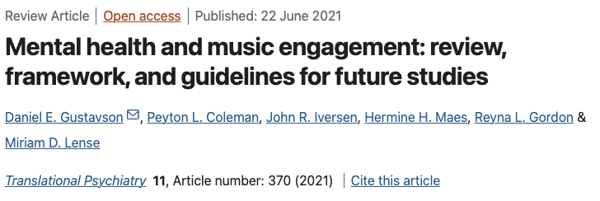

Background Information
Question: Can the effects of music on an individual’s mental health be predicted accurately based on their personal characteristics, music listening habits, and mental health indicators?

Slide 3
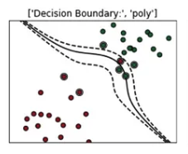
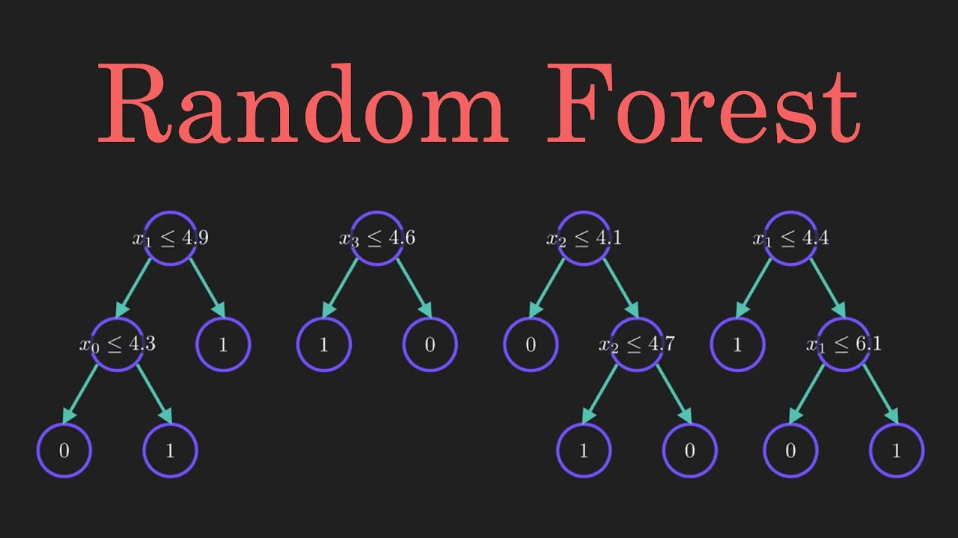
Machine Learning Modeling: RF & SVM (Poly)
3

Slide 4
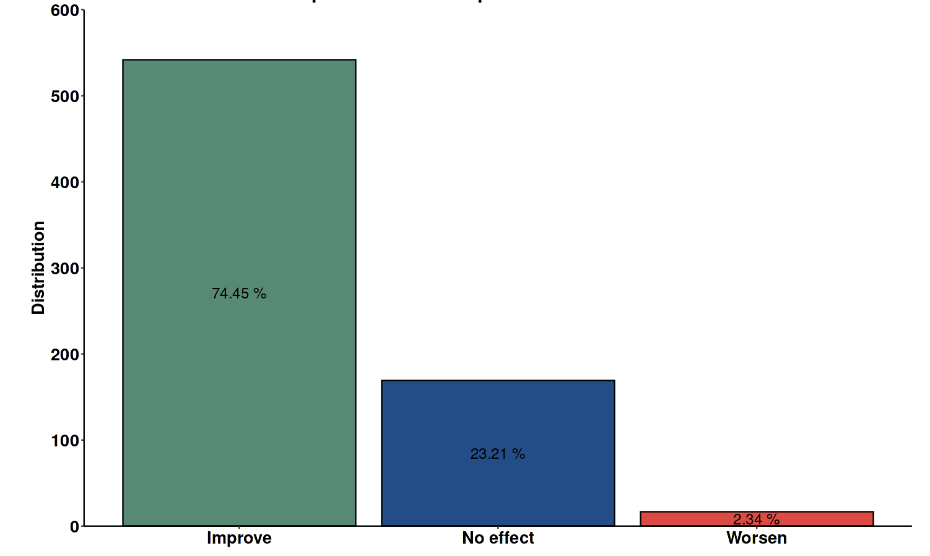
DATASET CHARACTERISTICS
4
Music effects

Slide 5
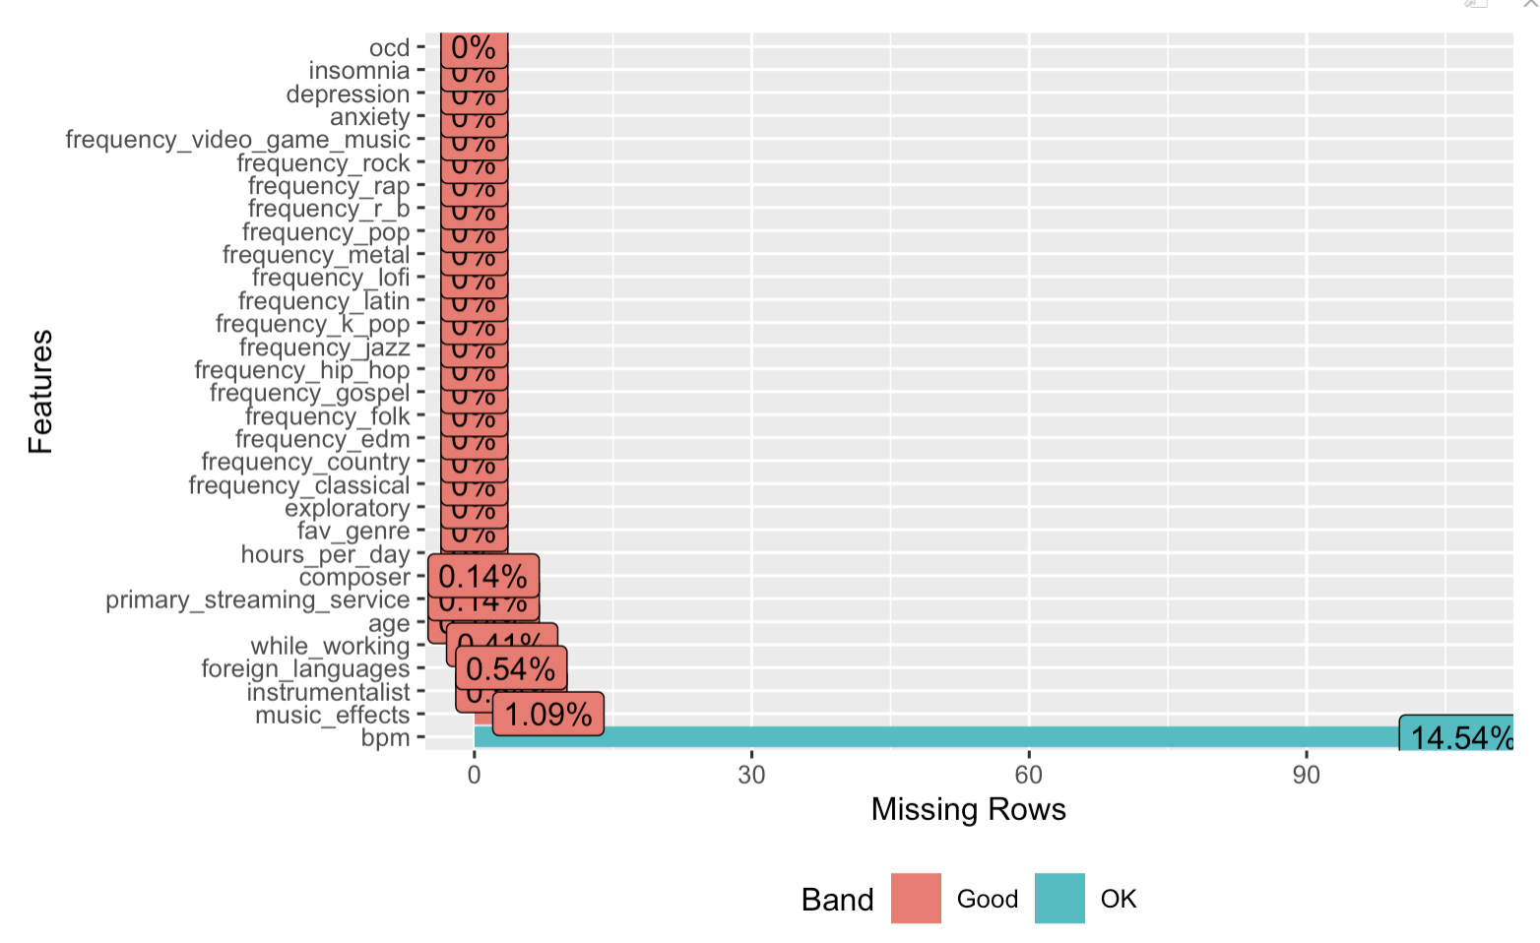
Preprocessing 1. Remove missing data : 126 values
5

Slide 6
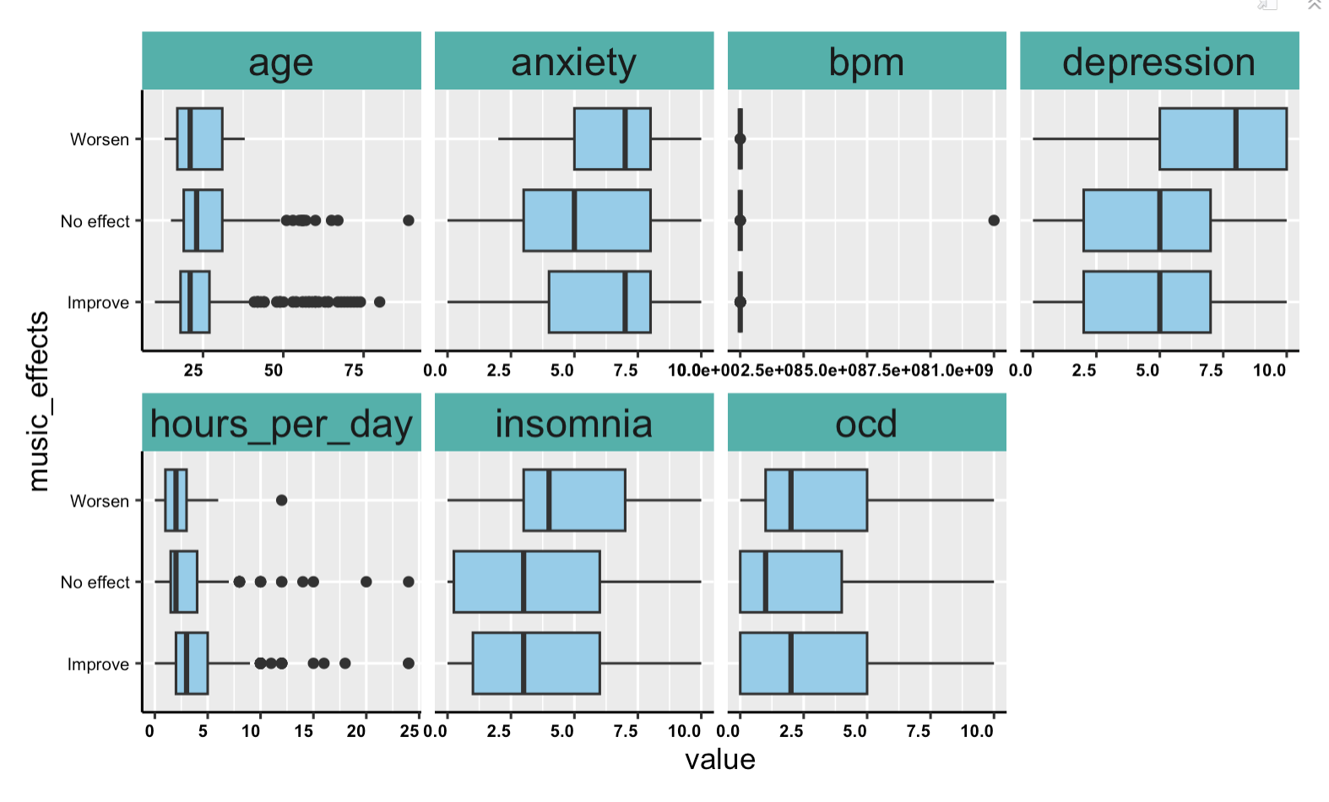
Preprocessing 2. Corrected outliers
6

Slide 7
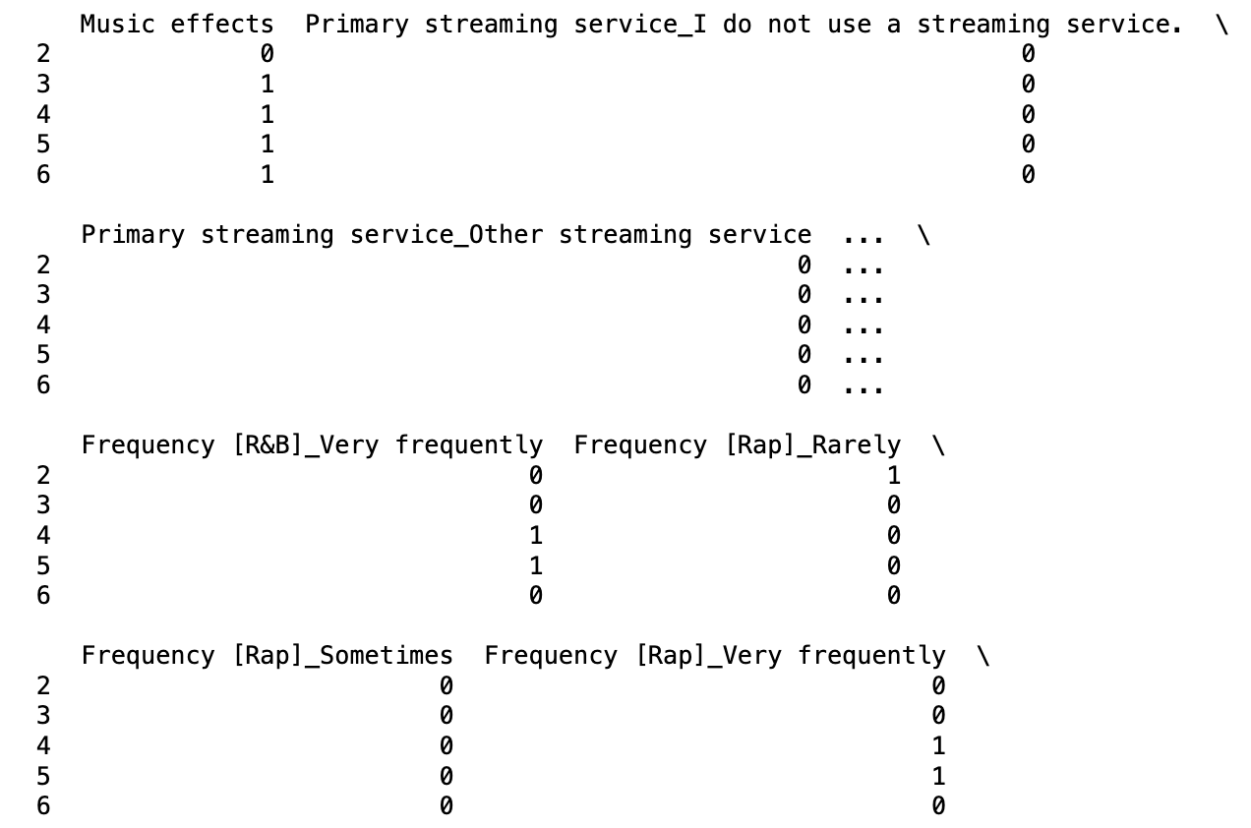
Preprocessing 3. One-hot encoding
7

Slide 8
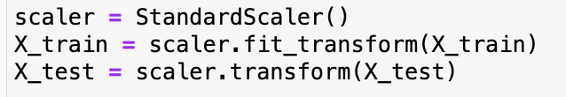
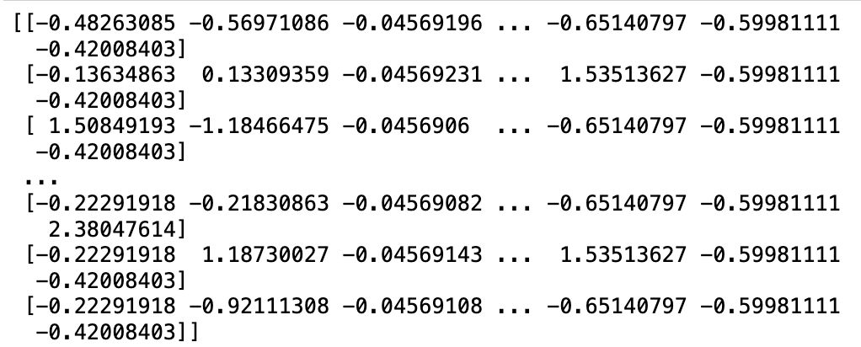
Preprocessing 4. Standardization
8

Slide 9
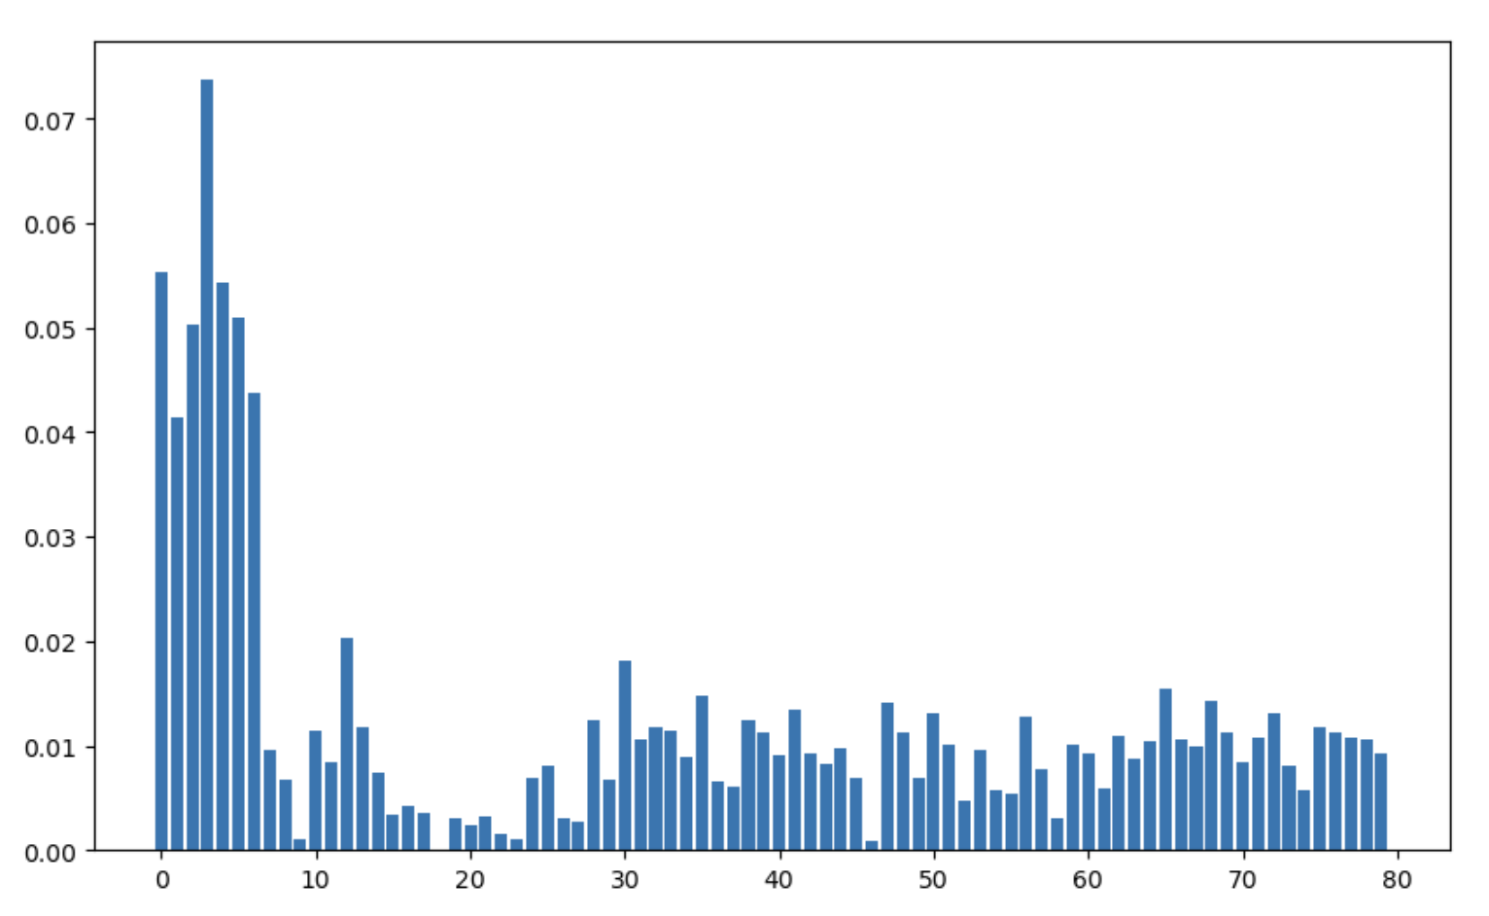
Feature Selection by Random Forest
9
Threshold of selection by mean: 0.0125
Number of selected features: 17
Threshold of selection by 75%: 0.01174
Number of selected features: 20
Notes:
Bar graph for importances of Random Forest

Slide 10
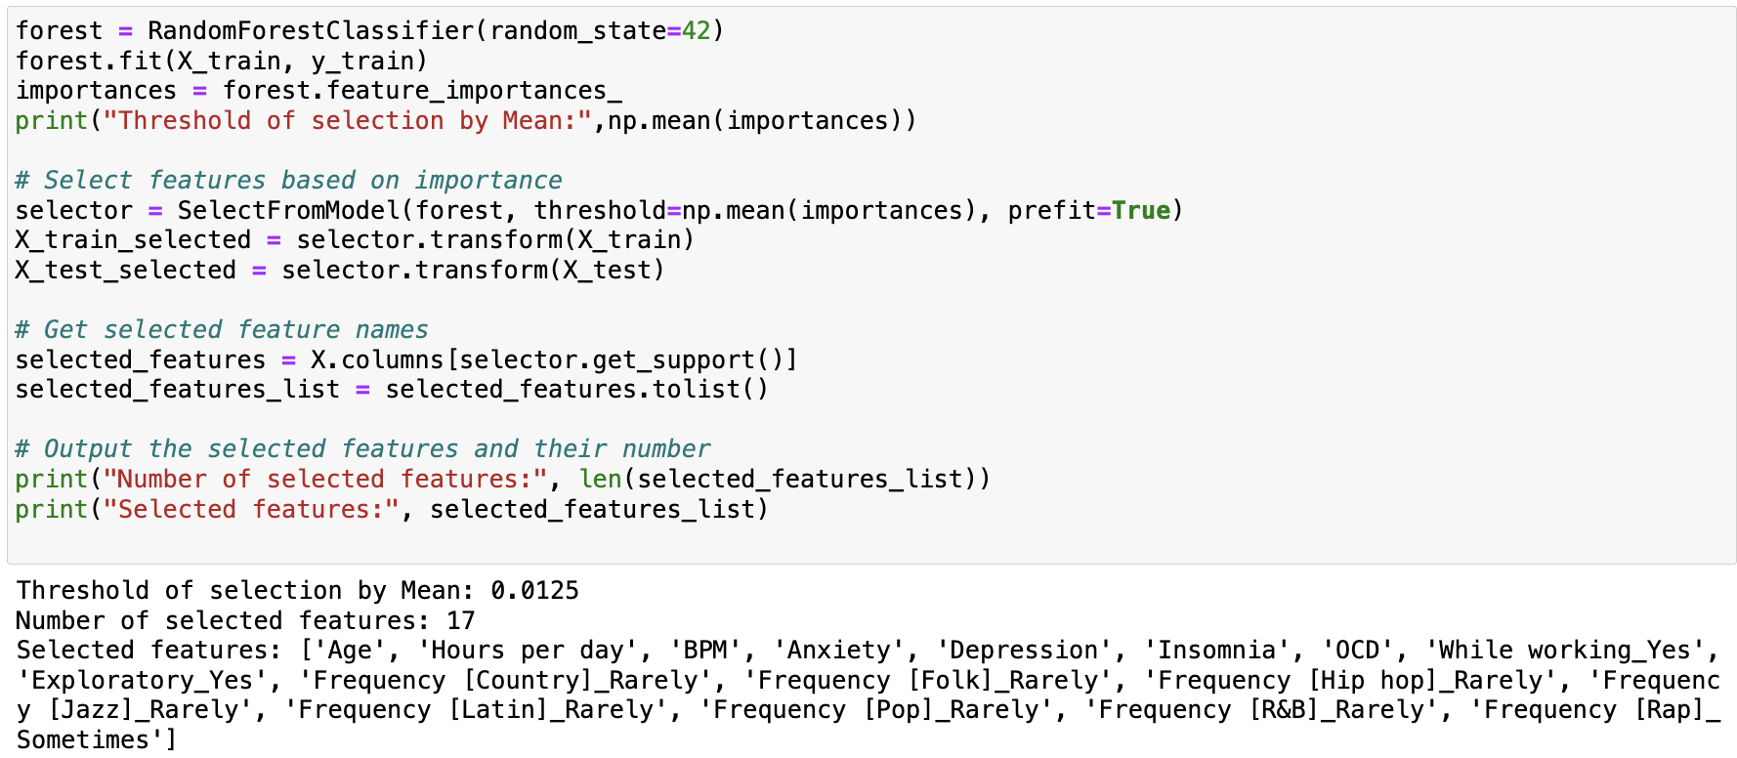
Python Code for Feature Selection
10

Slide 11
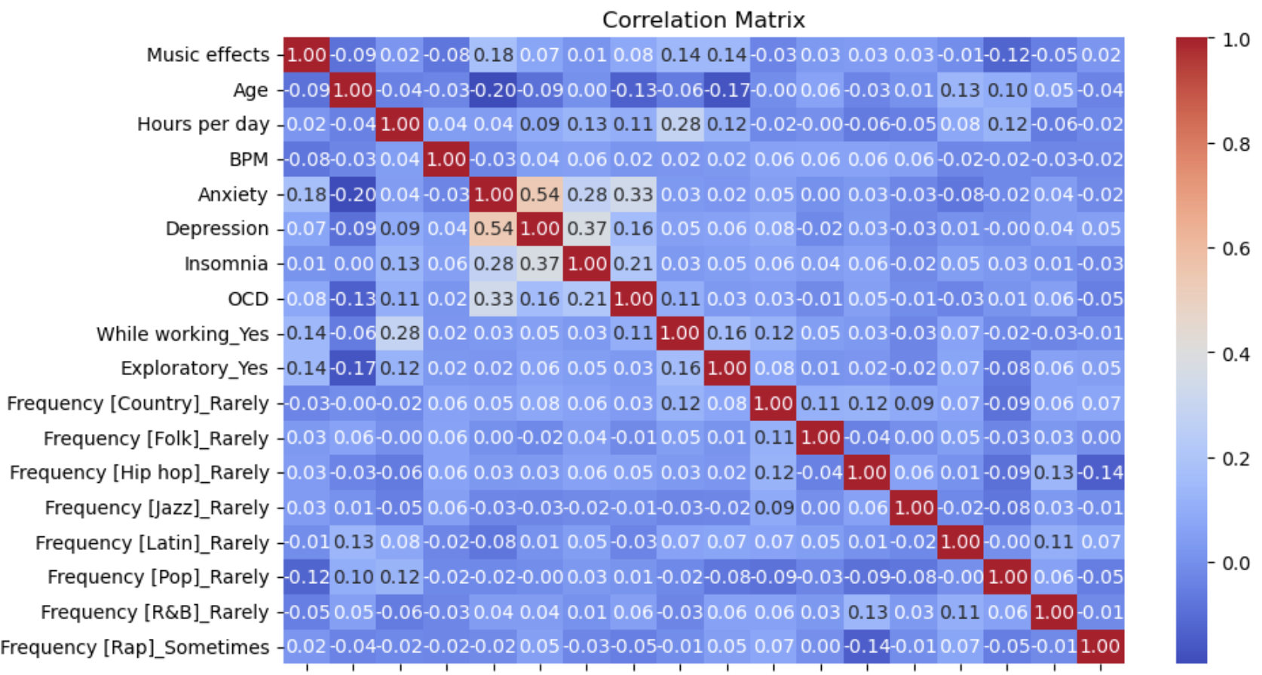
Correlation: Heatmap
11

Slide 12
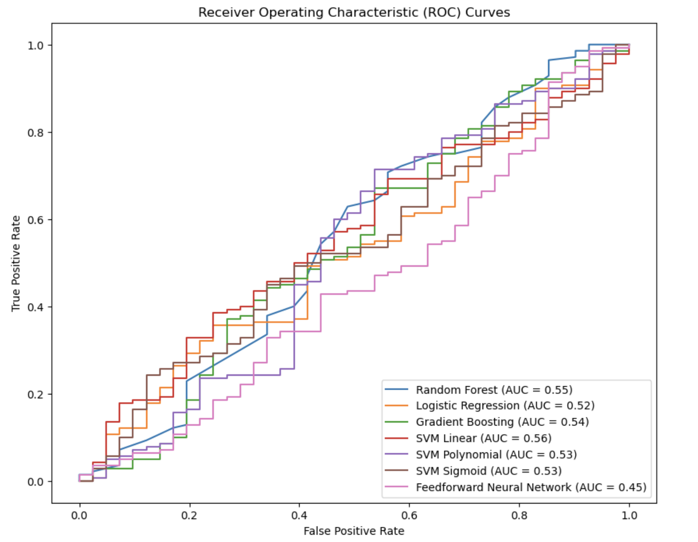
Python: Model Selection
12
Notes:
Considering this, the Polynomial Kernel SVM Model appears to be the best-performing model. It shows better predictions for class 0 while maintaining accurate predictions for class 1. Improving the recall for class 0 while maintaining the accuracy for class 1 could be the direction for further model improvement.

Slide 13
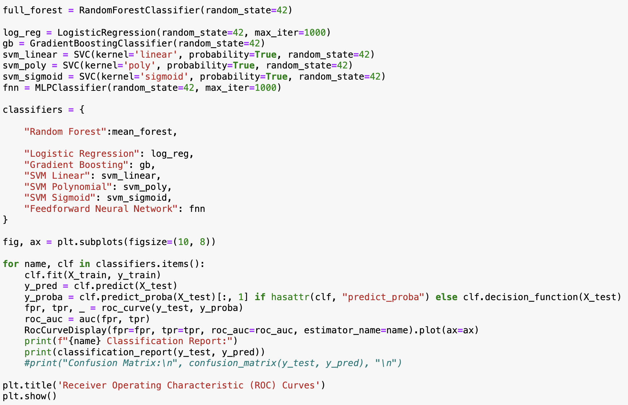
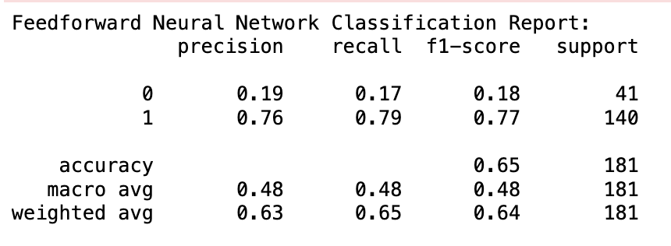
Python Code for Model Selection
13

Slide 14
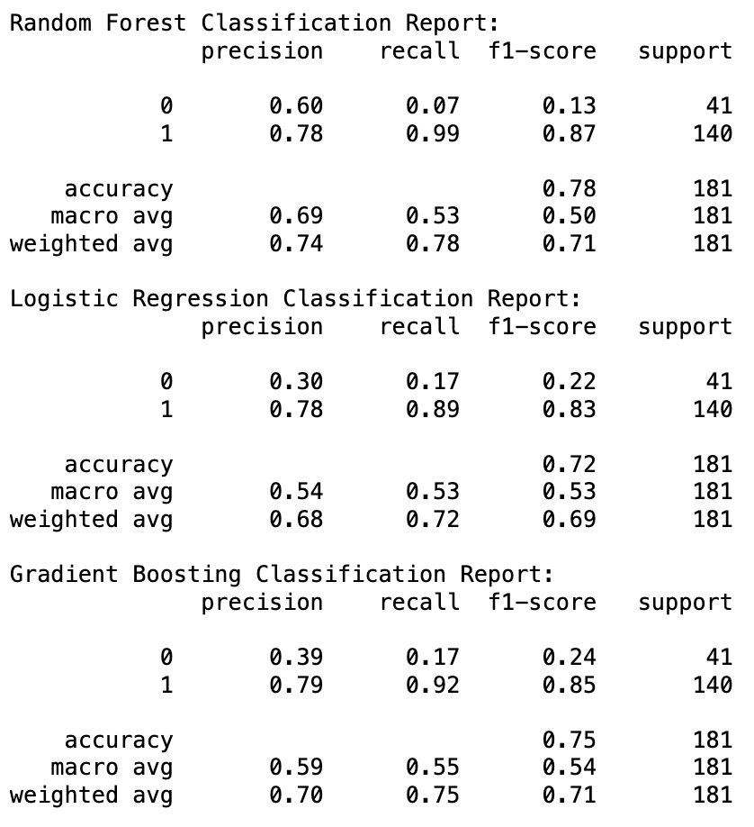
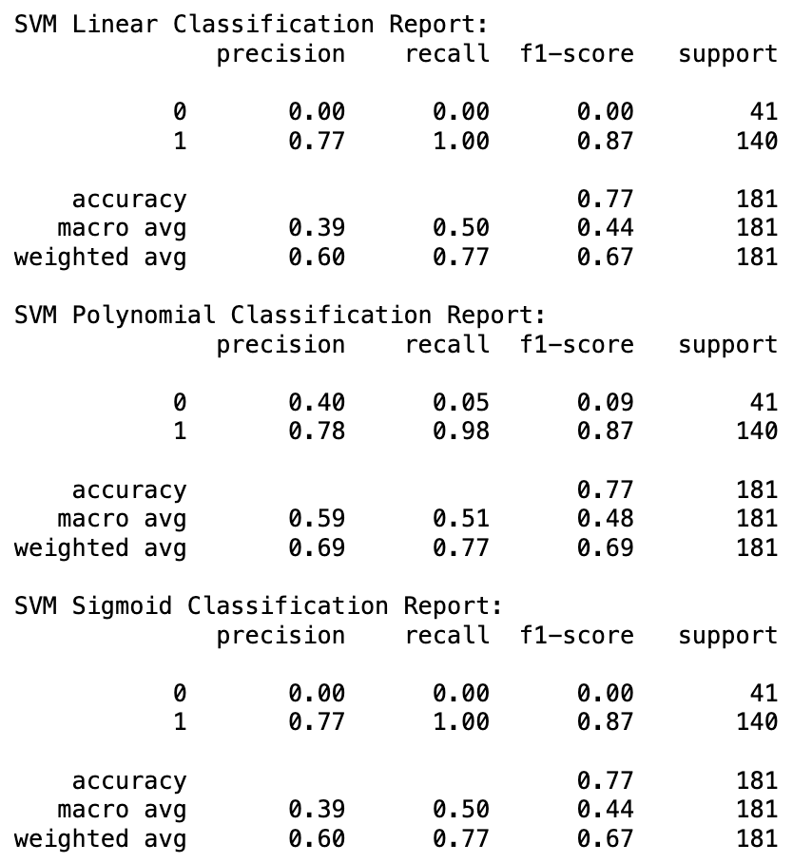
14
Python Output for Model Selection

Slide 15
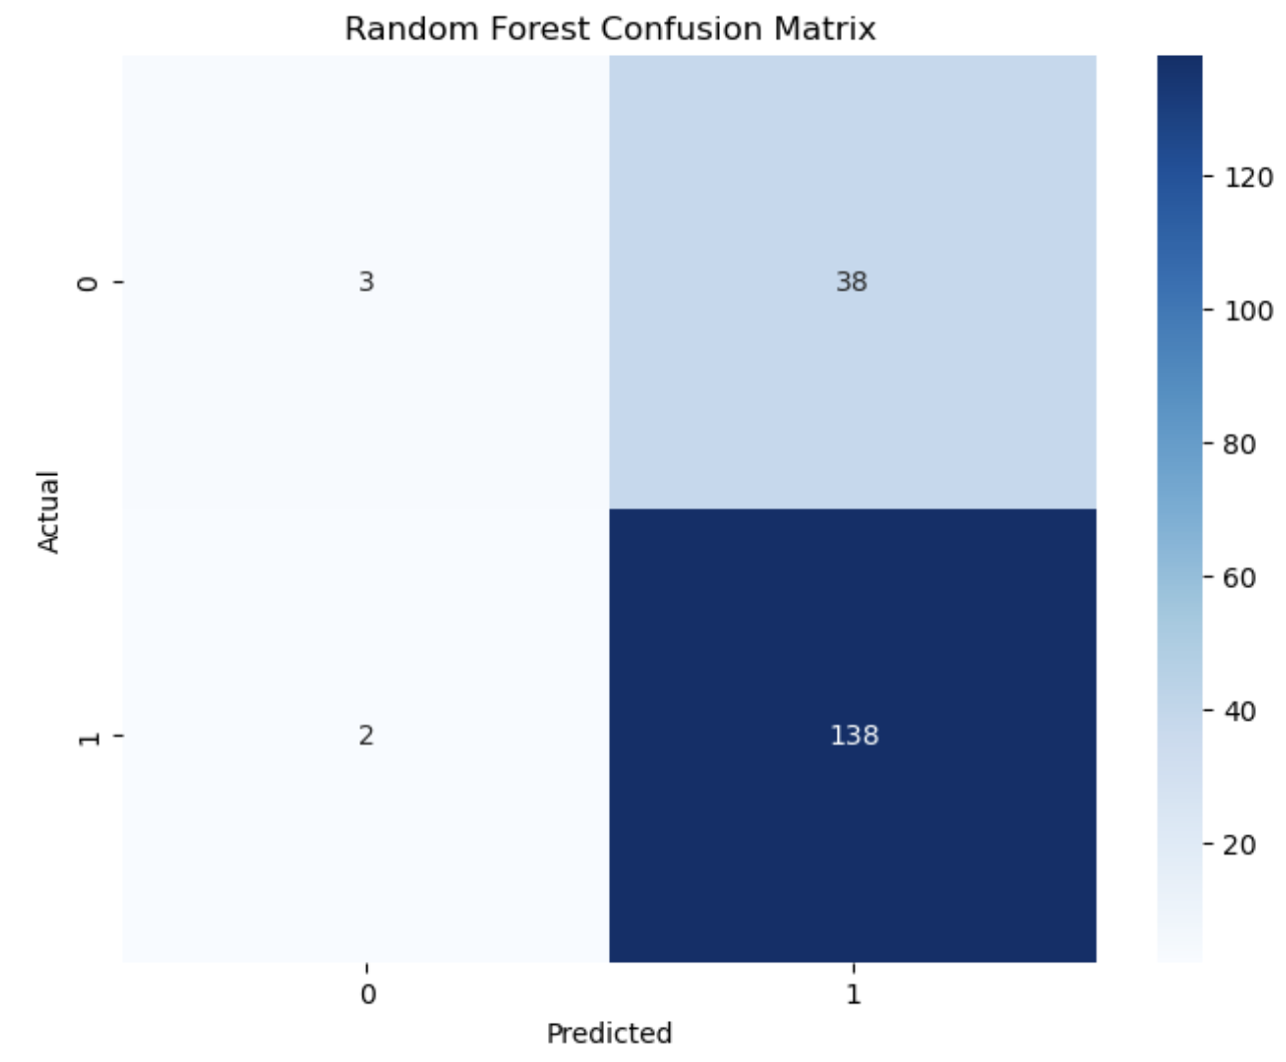
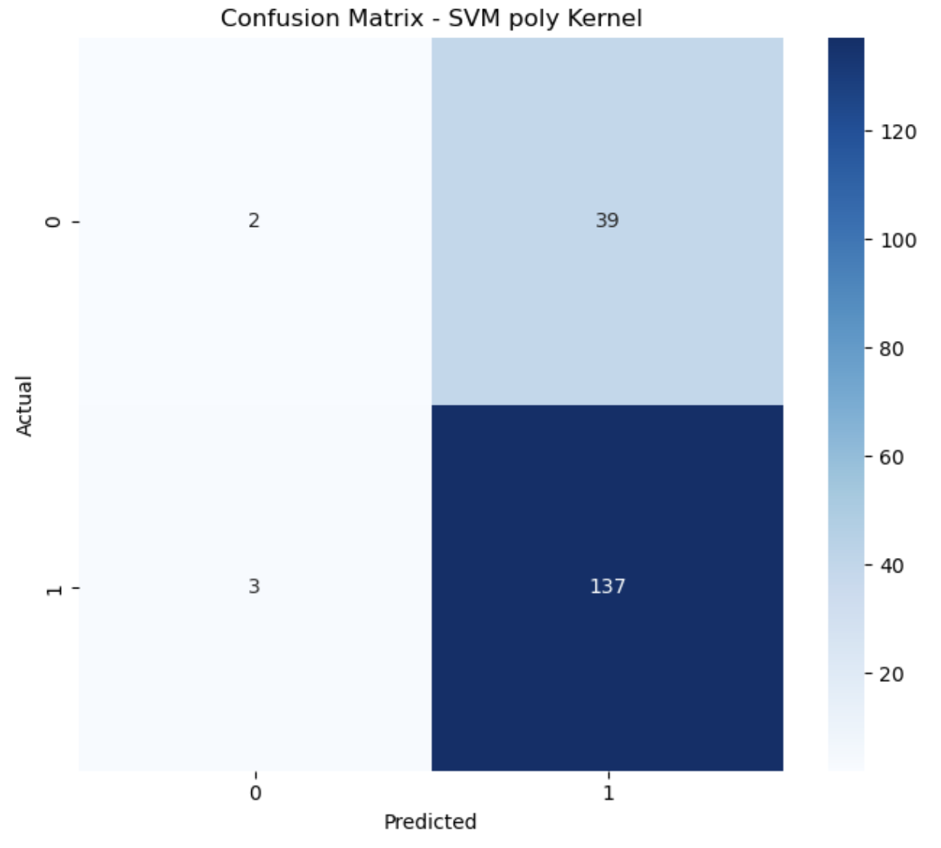
15

Slide 16
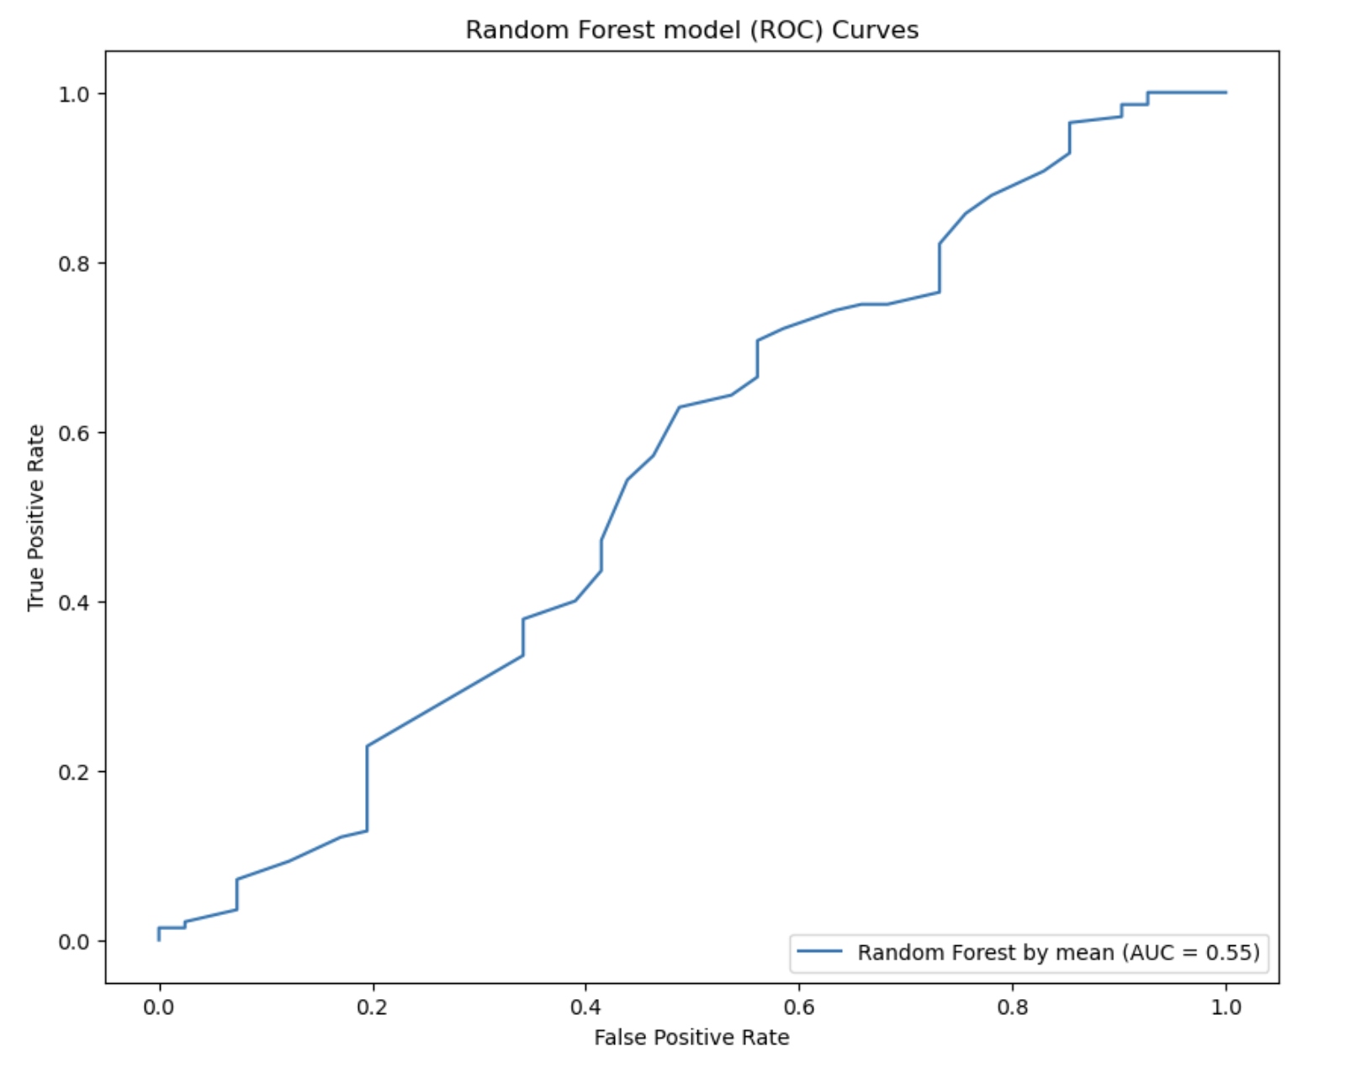
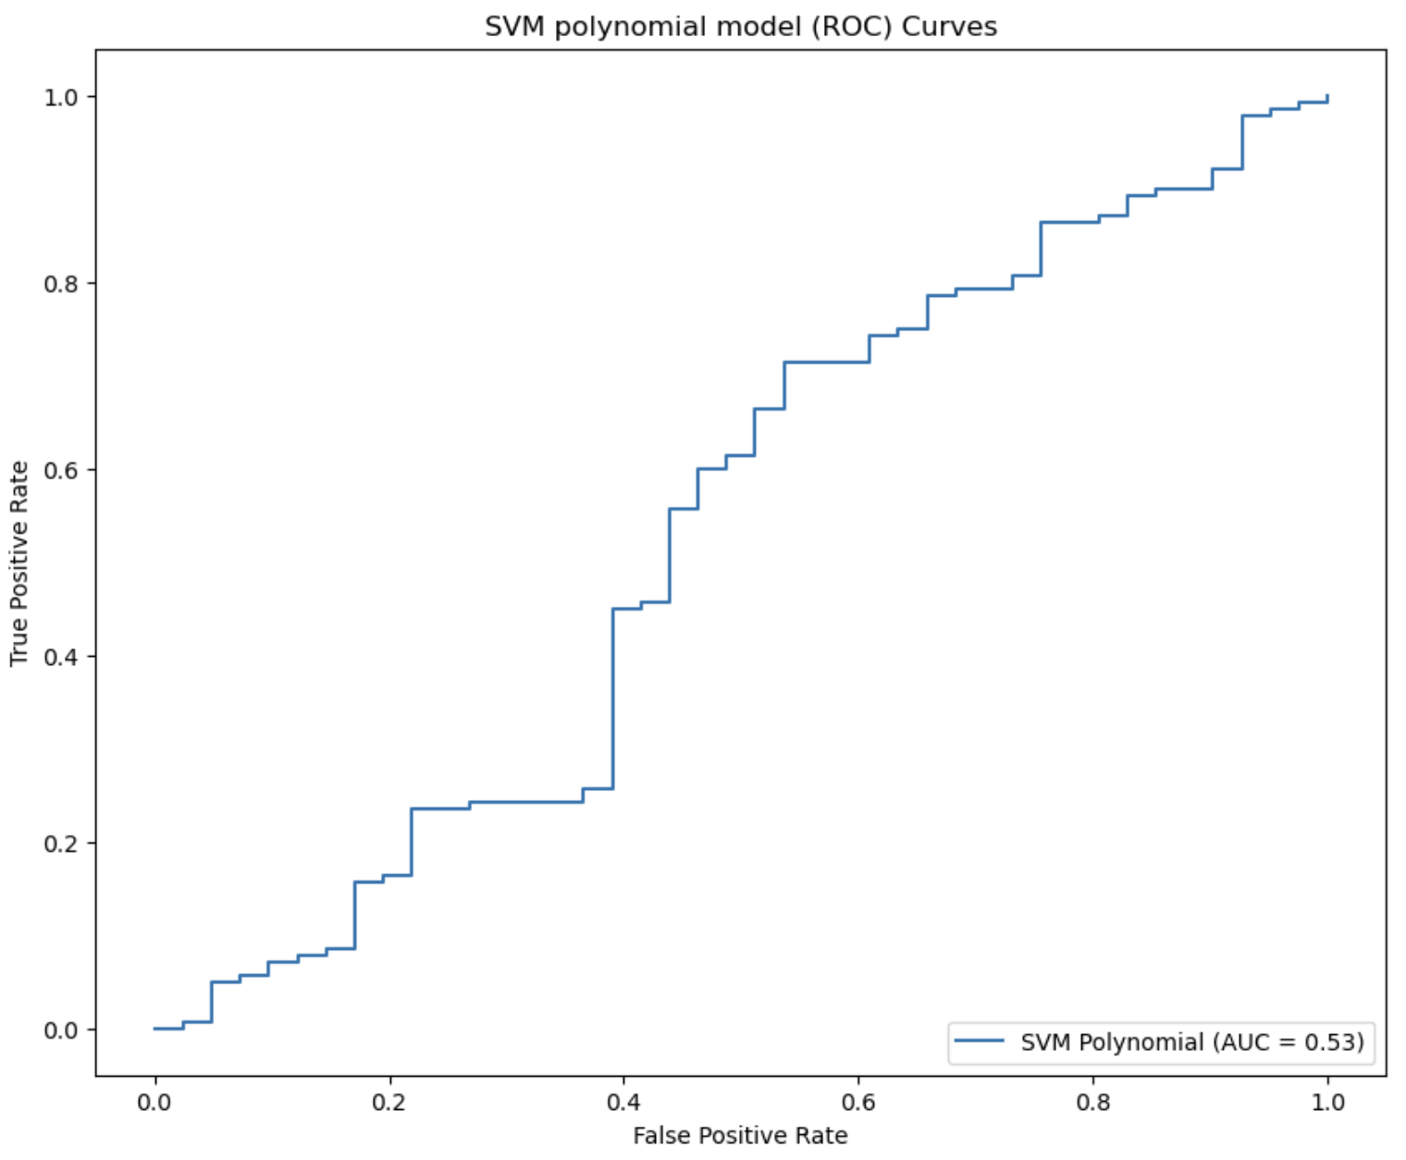
ROC Curves
16

Slide 17
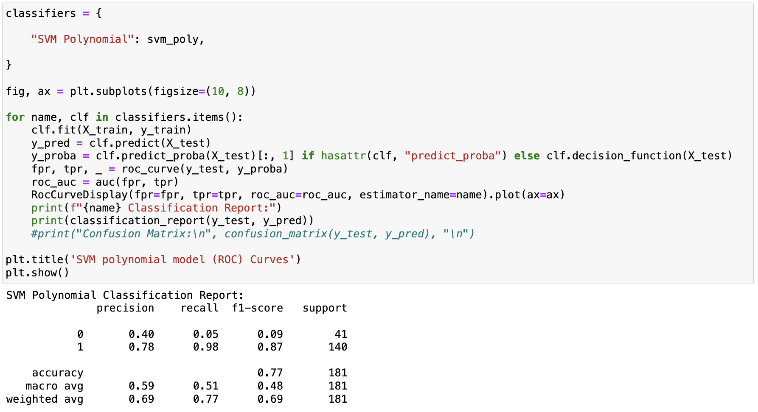
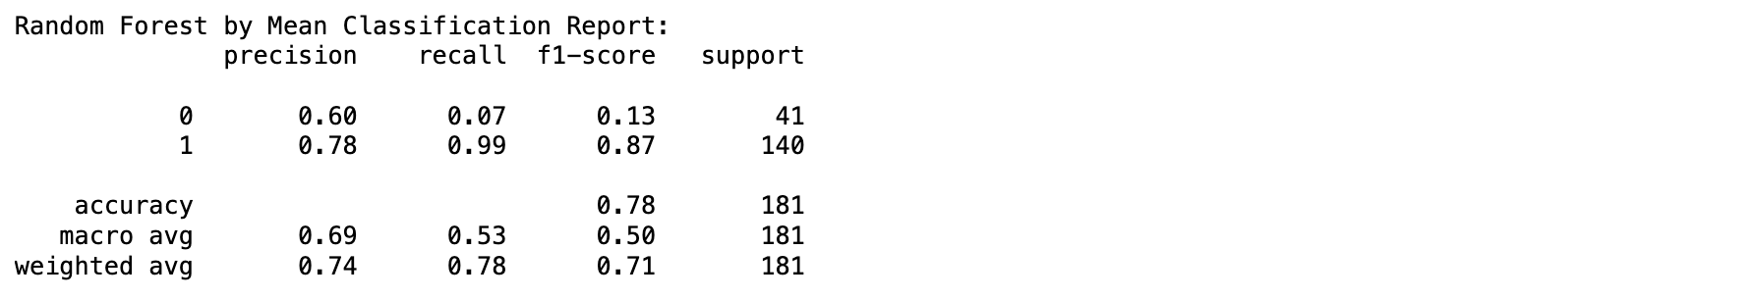
Python code for ROC curve and Outcome
17

Slide 18
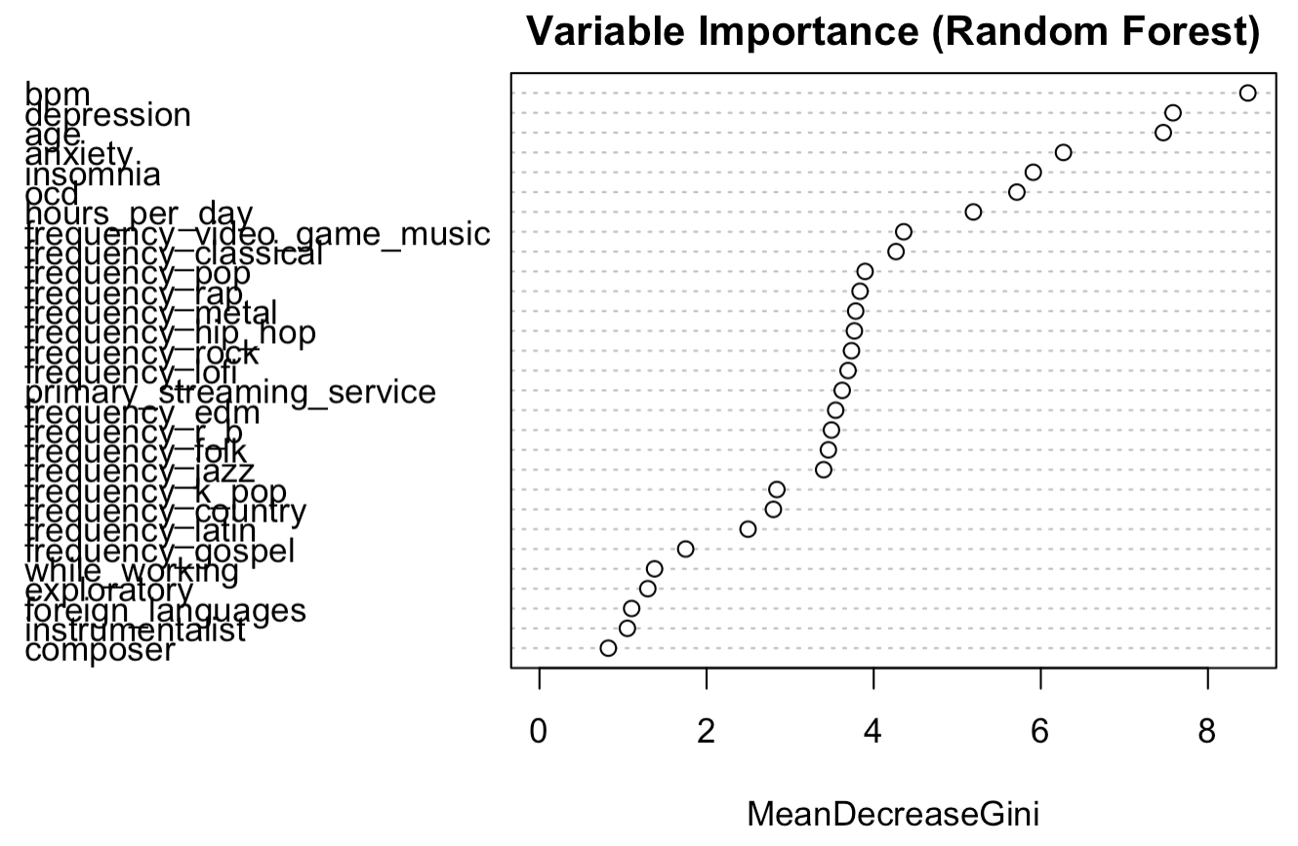
R: Random Forest
18

Slide 19
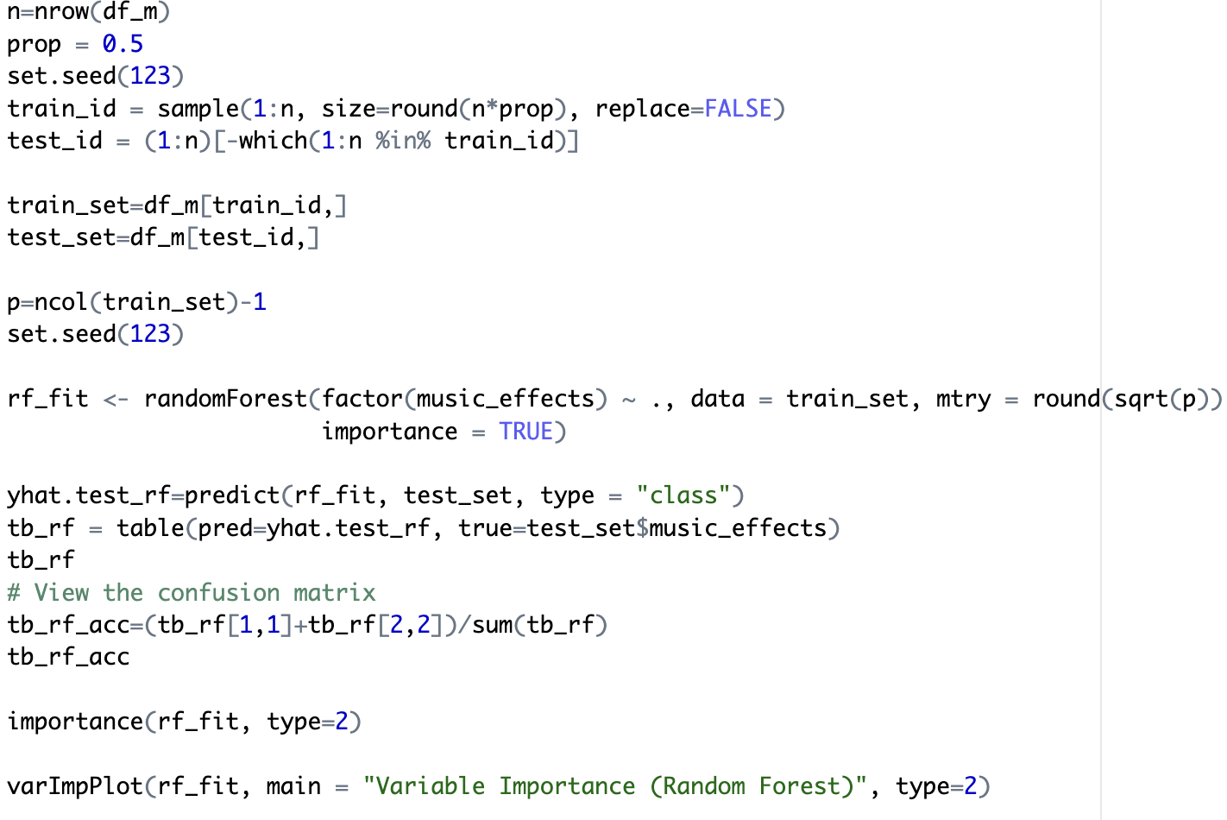
R code for Random Forest
19

Slide 20
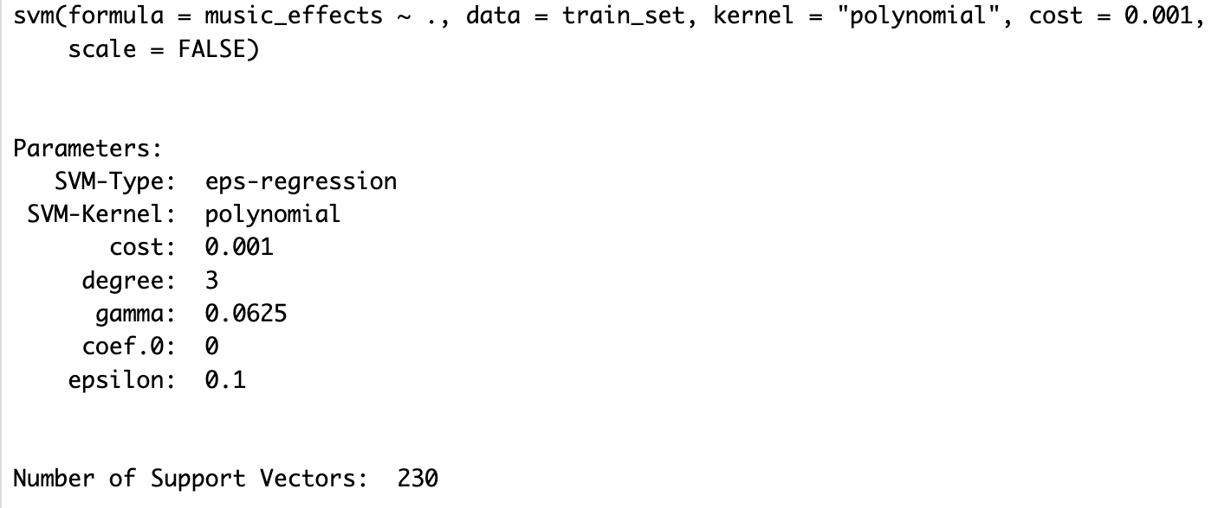
R: SVM Polynomial
20

Slide 21
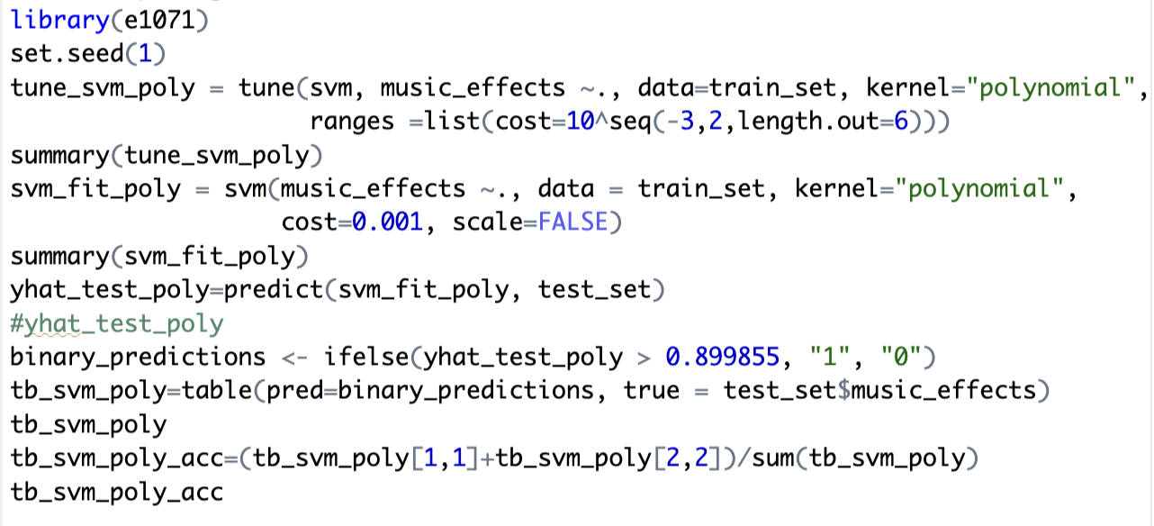
R code for SVM Polynomial
21

Slide 22
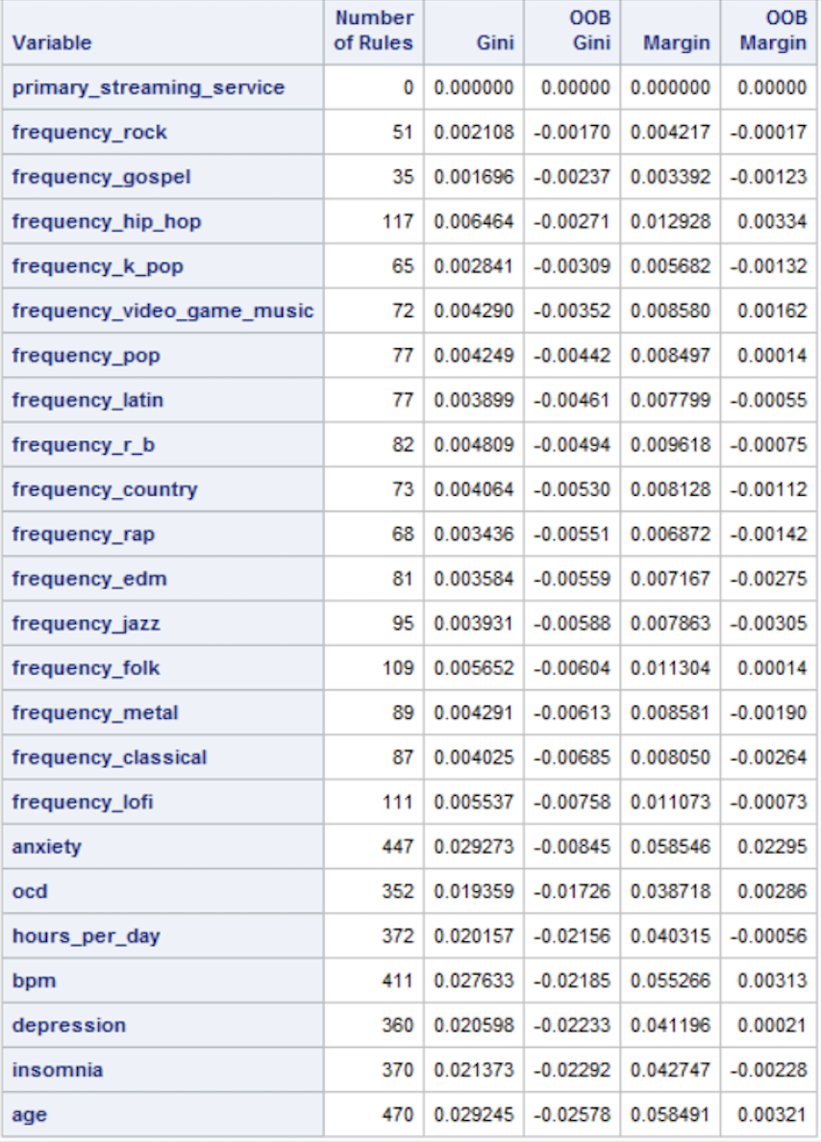
SAS:Random Forest
22

Slide 23
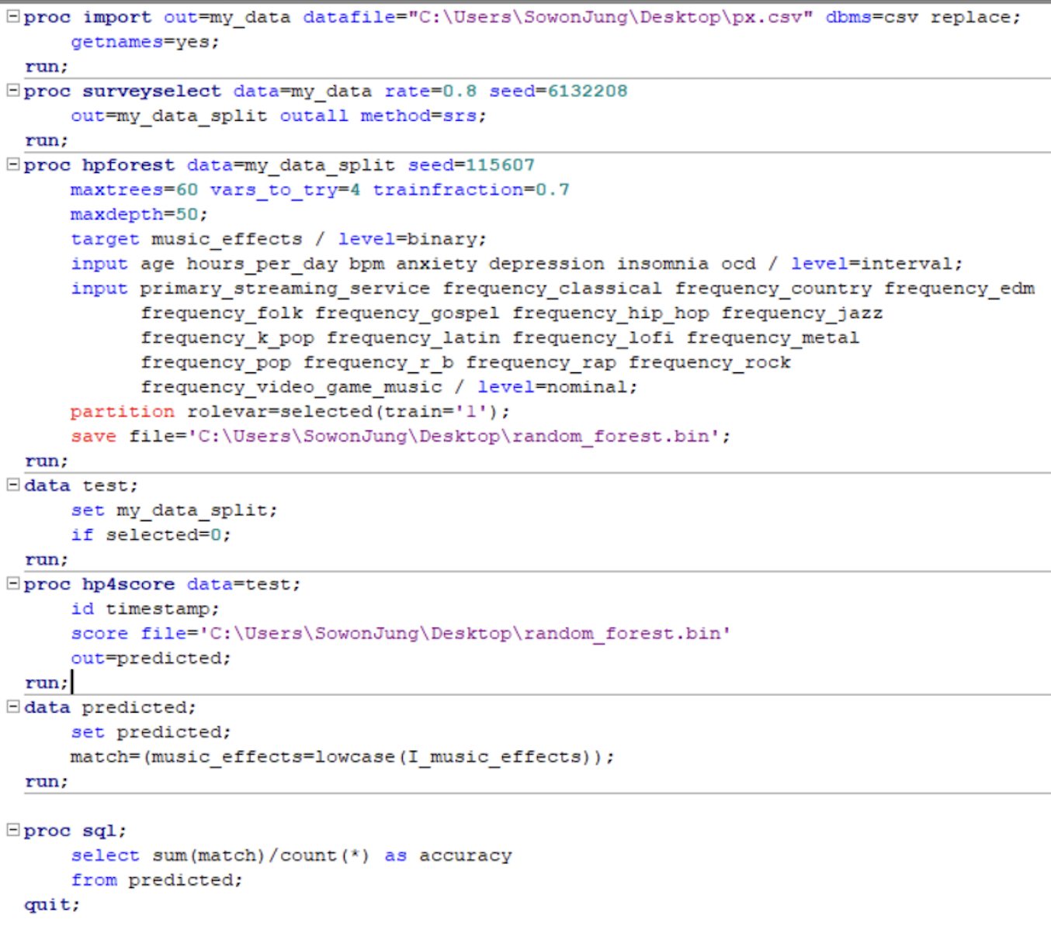
SAS code for Random Forest
23

Slide 24
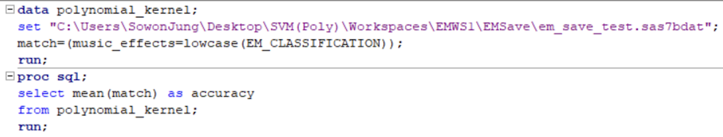
SAS: SVM Polynomial
24

Slide 25
Summary of Prediction Accuracy
25
Random Forest
SVM (Polynomial)
Python: 0.77901
R: 0.7375415
SAS: 0.791667
Python: 0.768
R: 0.744444
SAS: 0.736264
SAS Random Forest has the highest accuracy!

Slide 26
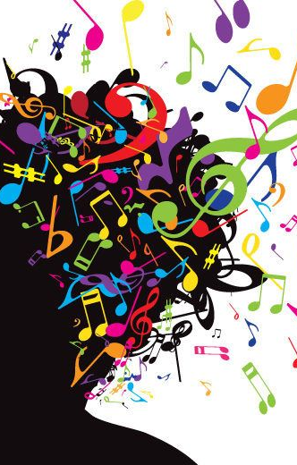
Implication & Future Studies
High accuracy supports the hypothesis that there is a measurable relationship between music listening habits (like genre preferences) and mental health outcome.
Music can have a predictable impact on disorders such as anxiety, depression, insomnia, and OCD.
Feature selection can lead to deeper inquiries into the mechanism through music affects mental health.
Further research can explore how these features interact with psychological process

Slide 27



Thank you!

